Slide 1
COOLEY-TUKEY FAST FOURIER TRANSFORM (FFT) ALGORITHM
CMPS 4563: GPU Programming.
Midwestern State University
Anthony Enem

Slide 2
PRESENTATION FLOW
The Fourier Series
The Fourier Transform
Discrete Fourier Transform
Fast Fourier transform
Cooley-Tukey Fast Fourier Transform
Sequential vs Parallel implementations of the Radix-2 DIT Cooley-Tukey FFT

Slide 3
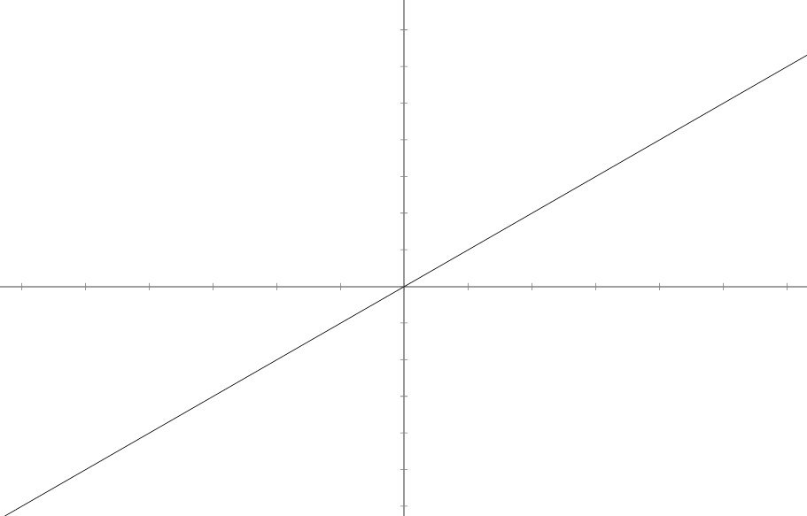
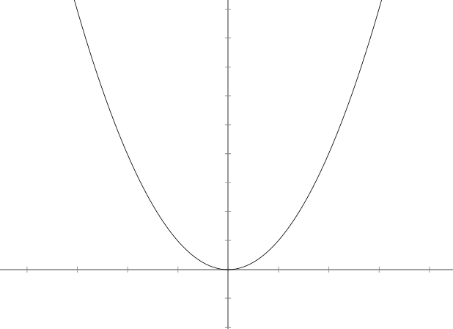
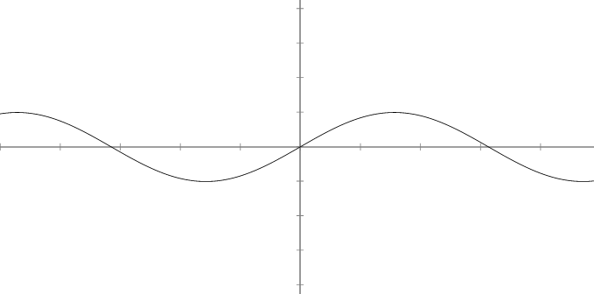
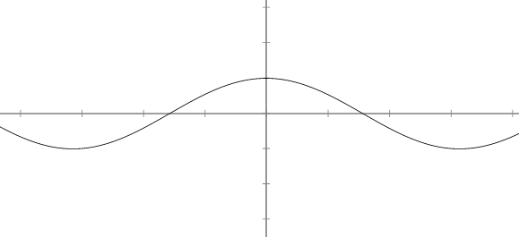
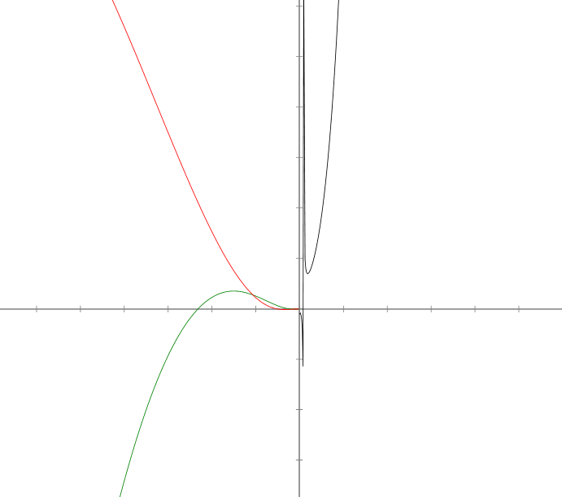
Fourier series
Some functions are Easy to work with
Predictable, periodical, infinitely differentiable, easy to analyze
Some other functions are not easy to work with
Complicated to analyze, might contain imaginary components
We can use the nice functions to approximate the difficult ones using linear combinations (adding specific “amounts” of simple functions)
FOURIER SERIES can be used for this purpose
y = x
y = x²
y = sin(x)
y = cos(x)
y = (x+1)² / sin(ln(x))

Slide 4
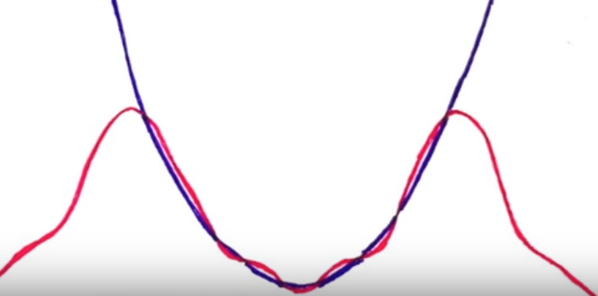
Fourier TRANSFORM
Fourier series only allows approximation in a specific interval [-L, +L]
We want something to approximate on the entire real line (-infinity, +infinity)
FOURIER TRANSFORM comes up with a way to estimate functions on the whole real line using only complex exponentials (e^{ikx})
Euler’s formula: e ^{i * theta} = cos(theta) + i sin(theta)
Real part = cos(theta) | Imaginary part = sin(theta)
So say we want to estimate a function f using e^{ikx}, we need to know how much of this exponential we need to add to get a good approximation
So we need a function of k to tell us how much of that complex exponential we need
2
FOURIER TRANSFORM
How much e^{i2x} we need for the approximation

Slide 5
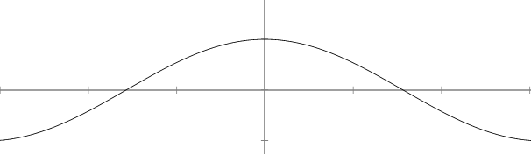
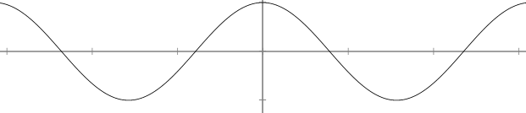
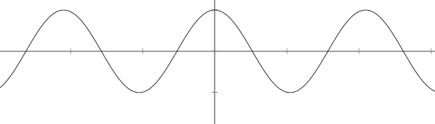
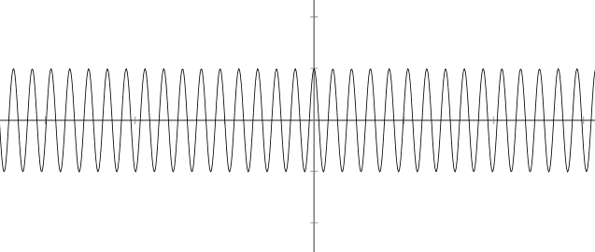
DISCRETE FOURIER TRANSFORM (DFT)
DFT is a process that analyses a time domain signal x[n], to determine the signal’s frequency content X[k]
Point? The DFT breaks down a signal (combination of complex exponentials) into equally spaced (discrete) samples (complex valued function of frequency).
How?: Comparing (correlate) the signal against sinusoidal basis functions
Sinusoidal basis functions: cosine and sine
X[k] = 1.6 + 2.7 i.
The higher the value, the more correlation (more similarities)
k is how many cycles are in the basis function over N samples
k = 1
k = 2
k = 3
k = 30

Slide 6
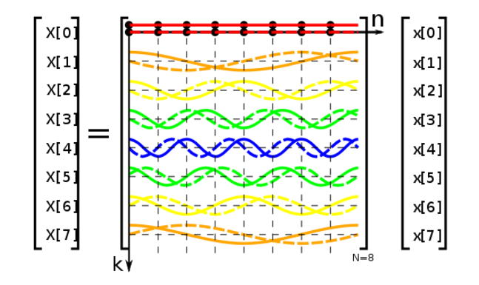
FAST FOURIER TRANSFORM (FFT) Finally!!!
The FFT computes the DFT of a sequence, converting a signal from its original domain to a representation in frequency domain and vice versa.
Wait. So why not use a DFT Algorithm instead?
Because FFT is “faster” (hence the “Fast” in Fast Fourier Transform)
Point? FFT reduces the complexity from O(n²) to O(nlog₂n)
How? By factorizing the DFT matrix into a product of mostly zero factors

Slide 7
Cooley-tukey fft algorithm
Re-expresses the DFT of an arbitrary composite size N=N₁N₂ in terms of N₁ smaller DFTs of size N₂ recursively to reduce computation time to Nlog₂N for high values of N
Example: for N = 8, DFT(8) = DFT₁(4) + DFT₂(4)
So 8 = 2 * 4. N₁ = 2, N₂ = 4. Then we have 2 smaller DFTs of size 4
This also means:
DFT(12) = DFT₁(6) + DFT₂(6) ; N₁ = 2, N₂ = 6, or
DFT(12) = DFT₁(4) + DFT₂(4) + DFT₃(4) ; N₁ = 3, N₂ = 4, or
DFT(12) = DFT₁(3) + DFT₂(3) + DFT₃(3) + DFT₄(3) ; N₁ = 4, N₂ = 3

Slide 8




Radix-2 DECIMATION-IN-TIME (DIT) case
Most simplest and most common form of the Cooley-Tukey Algorithm
Radix-2 DIT divides a DFT of size N into 2 DFTs of size N/2
Regular DFT Formula
Radix-2 DIT formula (Even and Odd portions)
Twiddle factored
Final Expression

Slide 9
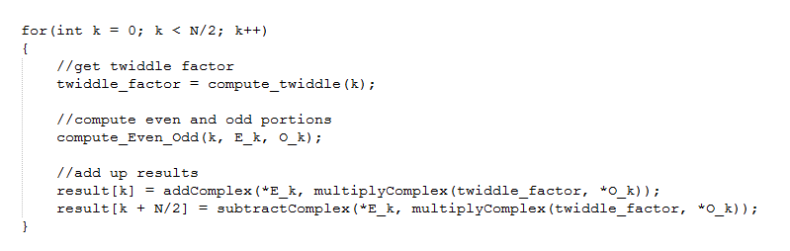
COMPUTING THE RADIX-2 DIT COOLEY-TUKEY ALGORITHM
Sequential
For loop from k = 0 to N/2
Calculate even, odd, and twiddle portions
Calculate X[k] and X[k + N/2] using even, odd and twiddle portions

Slide 10
COMPUTING THE RADIX-2 DIT COOLEY-TUKEY ALGORITHM (contd)
Parallel: Showing Example for N = 8
Each Thread assigned to compute each cell
So N * (N/2) threads ideally. But from we don’t have to compute even and odd potions from k = N/2.
Thus, number of threads needed = N/2 * N/2
Number of blocks needed = number_threads_needed / 1024 threads per block
Note: if number_threads_needed <= 1024, we use 1 block
k =
m =
0
0, 1, 2, 3
1
0, 1, 2, 3
2
0, 1, 2, 3
3
0, 1, 2, 3
4
0, 1, 2, 3
k =
m =
5
0, 1, 2, 3
6
0, 1, 2, 3
7
0, 1, 2, 3

Slide 11
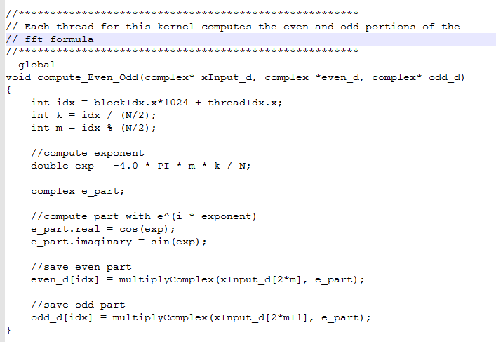

Slide 12
COMPUTING THE RADIX-2 DIT COOLEY-TUKEY ALGORITHM (contd)
Parallel (contd)
We need two even and odd arrays of size number_threads_needed
After computation of even and odd portions, addition is done in parallel using regression
The final values for even and odd components are then added to get X[k] and subtracted to get X[k + N/2]
k =
m =
0
0, 1, 2, 3
1
0, 1, 2, 3
2
0, 1, 2, 3
3
0, 1, 2, 3
4
0, 1, 2, 3

Slide 13
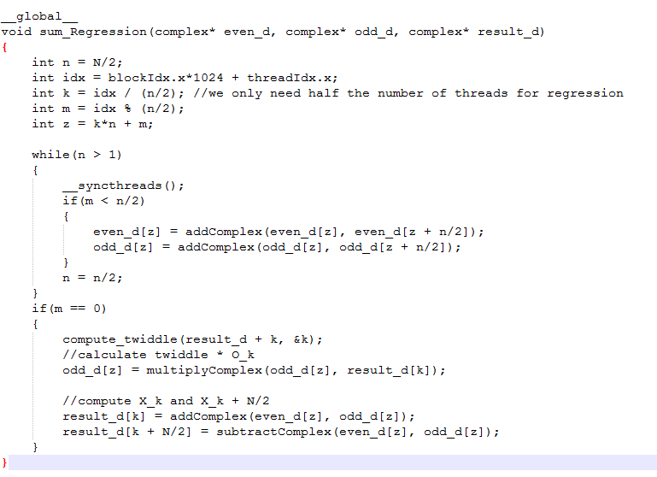

Slide 14
Results

Slide 15
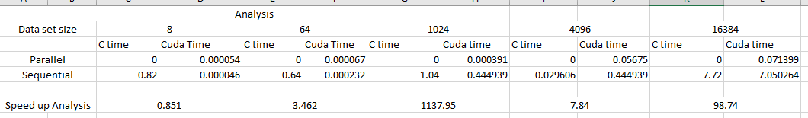

Slide 16
conclusion
The FFT is too complicated, so it is used for a lot of stuff
Signal processing
Image processing
Fast large integer and polynomial multiplication
Efficient matrix –vector multiplication
JPEG, MP3/MPEG encoding
A lot more stuf . . .

Slide 17
QUESTIONS?

